Slide 1

Fraud detection
Heberto Jimenez
Heb.jimenez@gmail.com

Slide 2
Outline
Executive Summary
Introduction
Methodology
Results
Conclusions

Slide 3
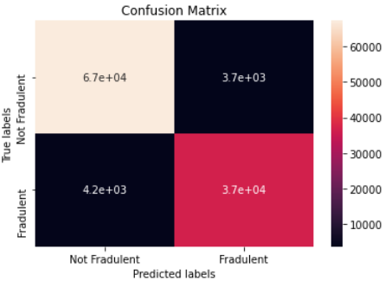
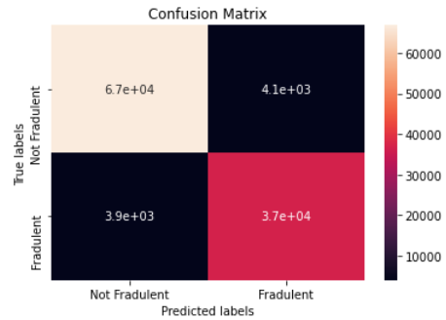
Executive Summary
The Study achieved in this project is focused on a fraud detection model in a payment transaction platform for XX enterprise, an agriculture online business. For this, a record of 570313 transactions have been evaluated with 4 different machine learning models: A decision tree classifier, random forest classifier, logistic regression and AdaBoost. Data was trained first, with a balanced set of the data and then tested in the unbalanced system that represents the real scenario. Project found 2 best models with a precision of ~93% each.
Accuracy for test with Decision Tree model is: 0.9297 Decision Tree model recall is: 0.9231
Decision Tree model precision is: 0.9297
Decision Tree model balanced F-score is: 0.9297
Accuracy for test with Random Forest model is: 0.9283
Random Forest model recall is: 0.9232
Random Forest model precision is: 0.9283
Random Forest model balanced F-score is: 0.9283

Slide 4
Introduction
Online payment platforms are being one of the main targets for cyber attackers. Reinforcement of the cyber security is vital to maintain these type of systems, being updated each day with new technology. Machine learning models have provided a tremendous help for these security systems, since no matter how strength it is, there will be a hacker that will brake into it. With these machine learning models; predictions of attacks or fraud transactions can be detected before hackers can even process it.
The project presents the study of an agriculture payment platform which its fraud transaction has raised during the pandemic. With the history of these transactions, the study will create a model that can predict if any transaction is going to be licit or fraudulent.

Slide 5

Section 1 Methodology

Slide 6
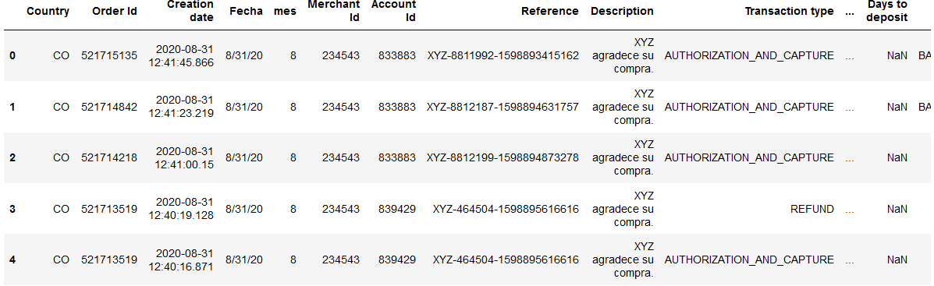
Data Collection
Data collected from payment platform is presented in a csv file, and it contains a total of 570313 transactions between March 1st, 2020, to August 31st, 2020, with 29 attributes such as: Processing Value, Date, response code and more.

Slide 7
Data Wrangling
As mentioned, there are a total of 29 attributes related to each transaction. However, no all attribute contains useful information, for example: Valor and processing value corresponds to the same value. Country refers to only one value, CO and so on. There are also a total of 1521918 missing values, and data is unbalanced.
Removing any unnecessary attribute.
Specify the target attribute.
Resample the data.
Remove missing values.

Slide 8
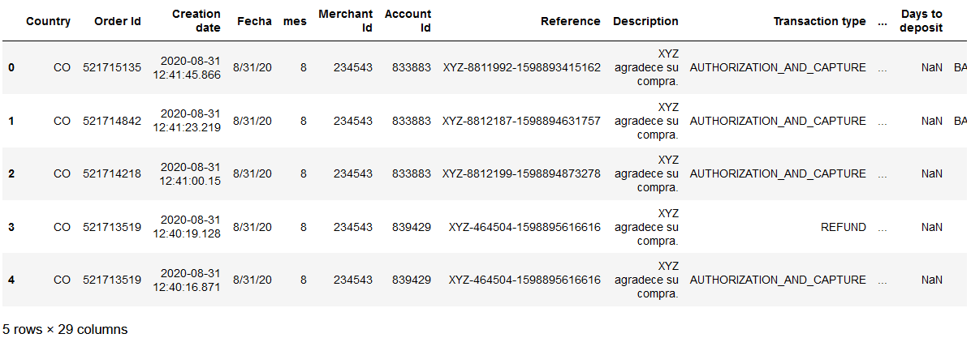
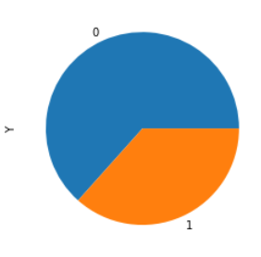
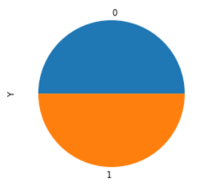
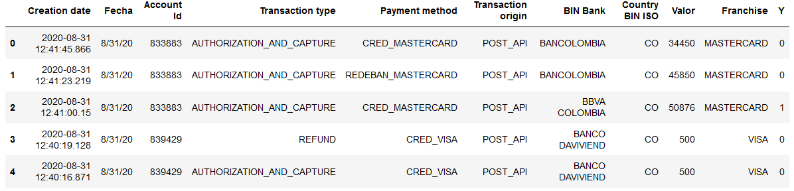
Data Wrangling

Slide 9
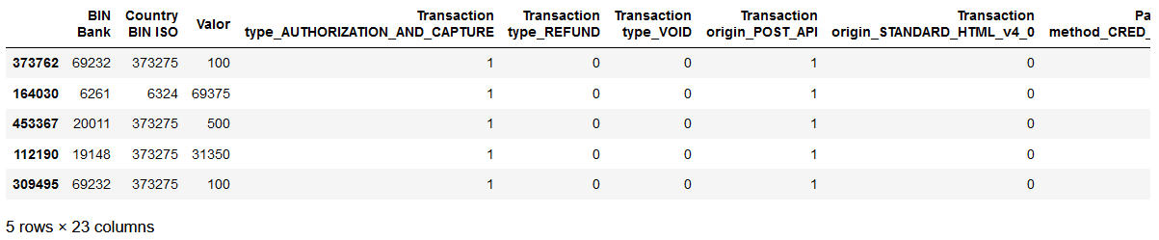
Data Wrangling
As seen before in pie chart, Y represents the response code: 1 if it is fraud and 0 if not.
Finally, encoding the categorical variables: Some of them with one hot encoding, and some other with a frequency encoding (BIN Bank and Country BIN ISO).

Slide 10
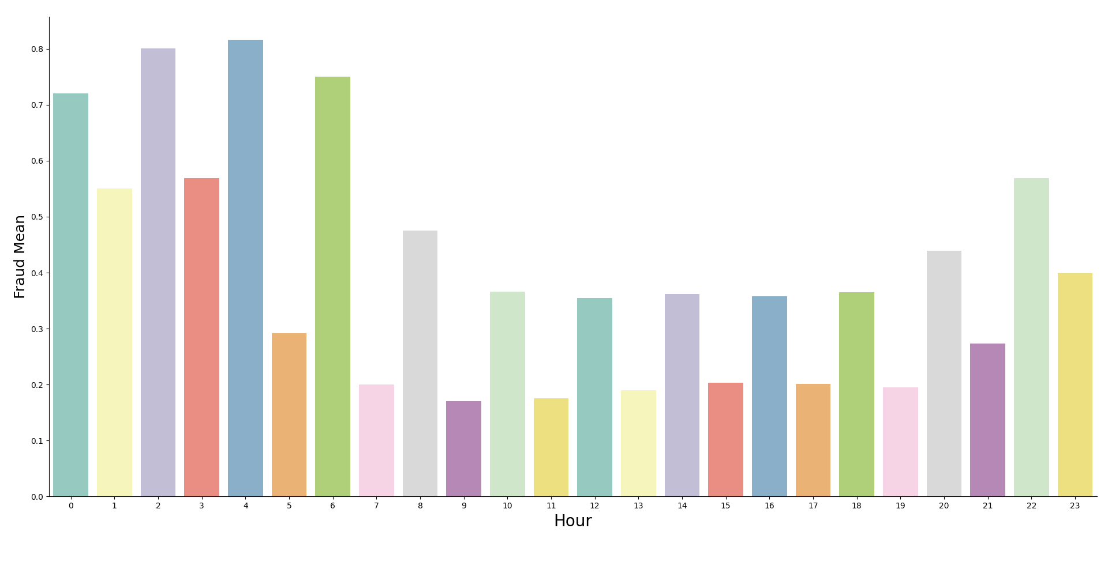
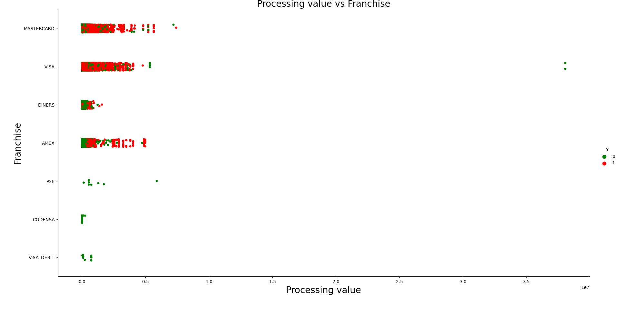
Data visualization
Hours of a day vs Fraud mean during the hour
Processing value vs Franchise

Slide 11
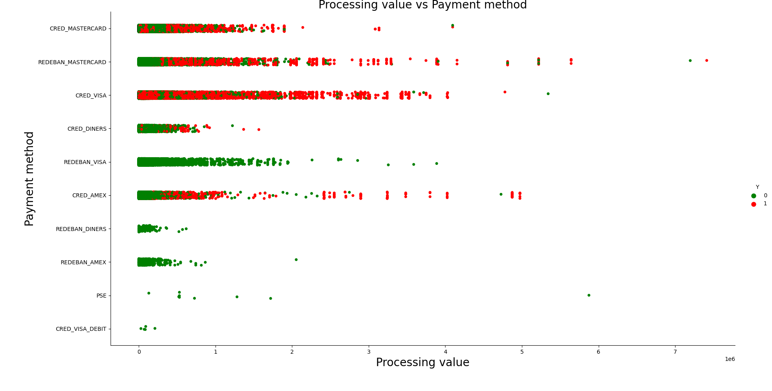
Data visualization
As seen in the graphics above, the hour of the transaction and the payment method have a relationship with the fraud assumption, but one of the most important characteristic, is the processing value

Slide 12
Machine learning models
Since data is unbalance a new set of balanced data is created in order to train a fit the models, due to the kind of problem, 4 machine learning models are suggested: Decision tree classifier, random forest classifier, logistic regression and AdaBoost. After the models are trained, a validation process is done in order to obtain the best model. With the set of best models, the data is tested with the original data set.
lr = LogisticRegression(random_state=42)
dt = DecisionTreeClassifier()
rf = RandomForestClassifier()
ada = AdaBoostClassifier()

Slide 13
Machine learning models
A GridsearchCV for best parameters was applied, however, it did not provide much improvement on data, related to machine training time.

Slide 14
Section 2 Results

Slide 15
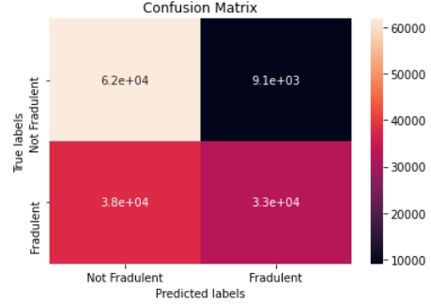
Logistic Regression
Accuracy: 0.67

Slide 16
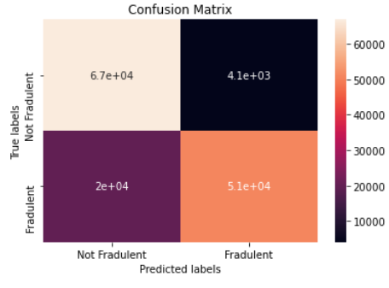
ADA Boost
Accuracy: 0.83

Slide 17
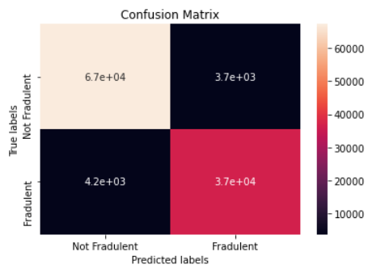
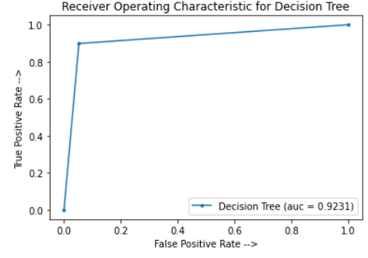
Decision Tree
Since the results for models above are not good enough, more information is gathered just for the best models.
Accuracy for test with Decision Tree model is: 0.9297
Decision Tree model recall is: 0.9231
Decision Tree model precision is: 0.9297
Decision Tree model balanced F-score is: 0.9297

Slide 18
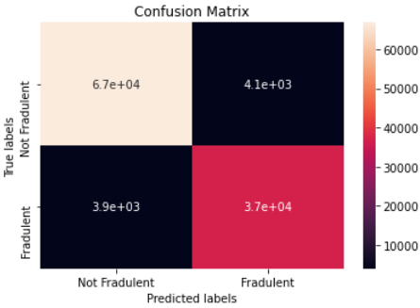
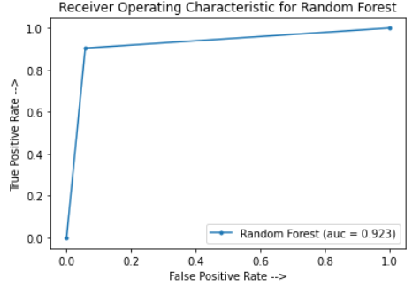
Random Forest
Accuracy for test with Random Forest model is: 0.9283
Random Forest model recall is: 0.9232
Random Forest model precision is: 0.9283
Random Forest model balanced F-score is: 0.9283

Slide 19
Conclusions
A fraud detection machine learning model can be implemented in the payment platform, since it will provide an accuracy above 90%.
The model is good at predicting no fraud transaction but needs improvement predicting fraud transaction.
Decision Tree and random forest provides almost the same results, system can use any of these models.

